Slide 1
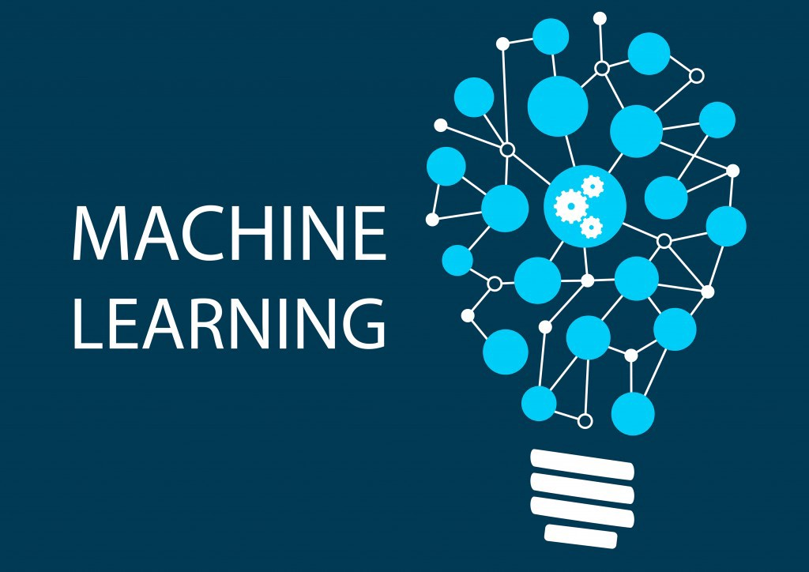
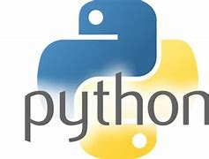
Introduction to using
Tue Vu, PhD.
AI & ML Research Scientist
SMU - OIT

Slide 2

OIT: RESEARCH TECHNOLOGY SERVICE

Slide 3

Outlines:
1. Introduction to Machine Learning
2. Why Python
3. Types of Machine Learning
4. Scikit-Learn
5. Supervised Learning
6. Unsupervised Learning

Slide 4
1. Introduction to Machine Learning
Artificial
Intelligence
Machine
Learning
Deep
Learning

Slide 5
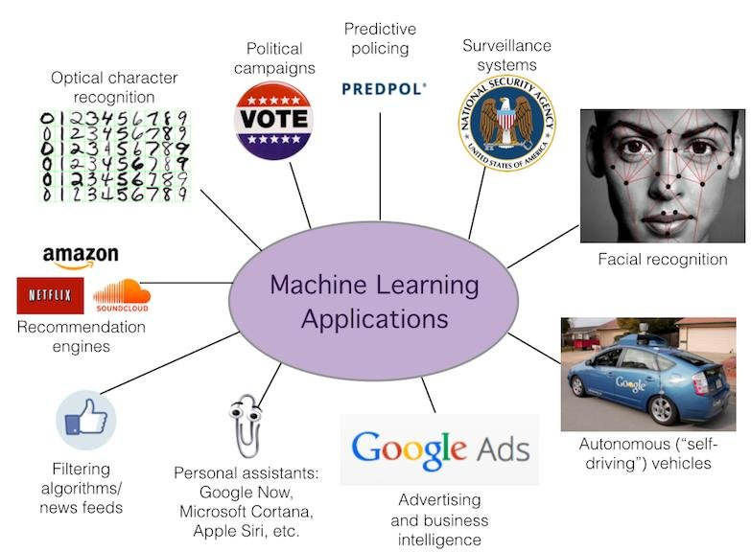
1. Introduction to Machine Learning
https://www.researchgate.net/publication/323108787_Introduction_to_Machine_Learning

Slide 6
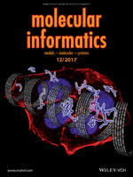
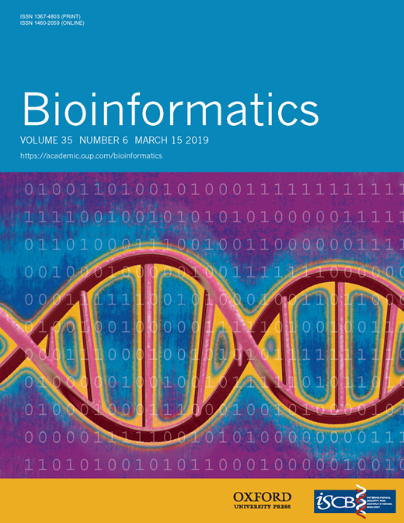

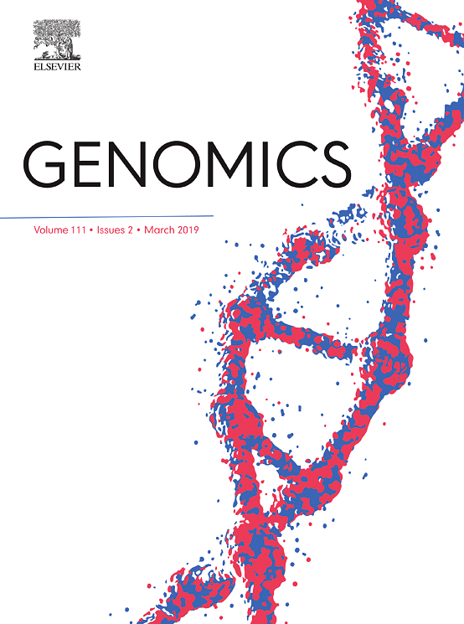


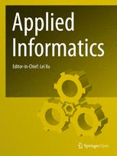
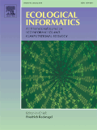
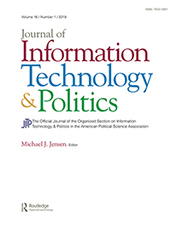
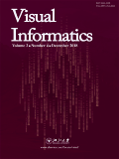
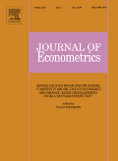
1. Introduction to Machine Learning

Slide 7
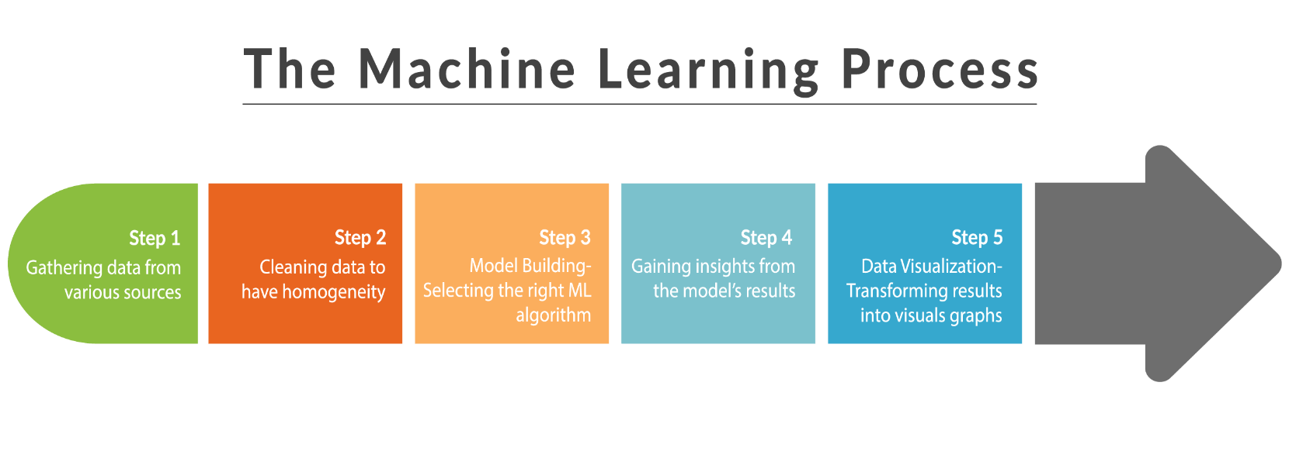
1. Introduction to Machine Learning

Slide 8
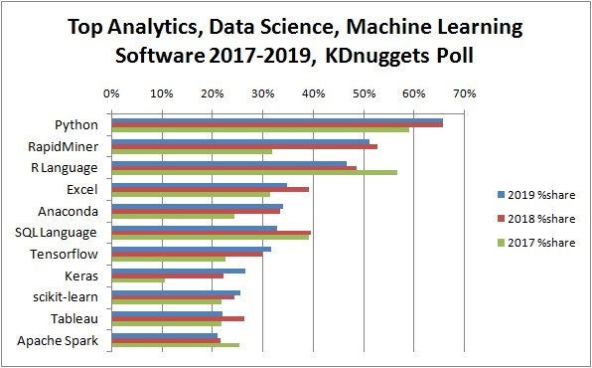
2. Why Python?
Python is used by the best data scientists in the world. In surveys on Kaggle (the competitive machine learning platform), Python is by far the most used machine learning tool.
Python is powerful because of the breadth of techniques it offers. The platform has more techniques than any other that you will come across.
Python is state-of-the-art because it is used by both academics and industry.
Python is free because it is open source software. You can download it right now for free and it runs on any workstation platform you are likely to use.
Python is a great tool for Machine Learning and Deep Learning. PhD students and researchers need lots of power for their studies and publications
https://www.kdnuggets.com/2019/05/poll-top-data-science-machine-learning-platforms.html

Slide 9
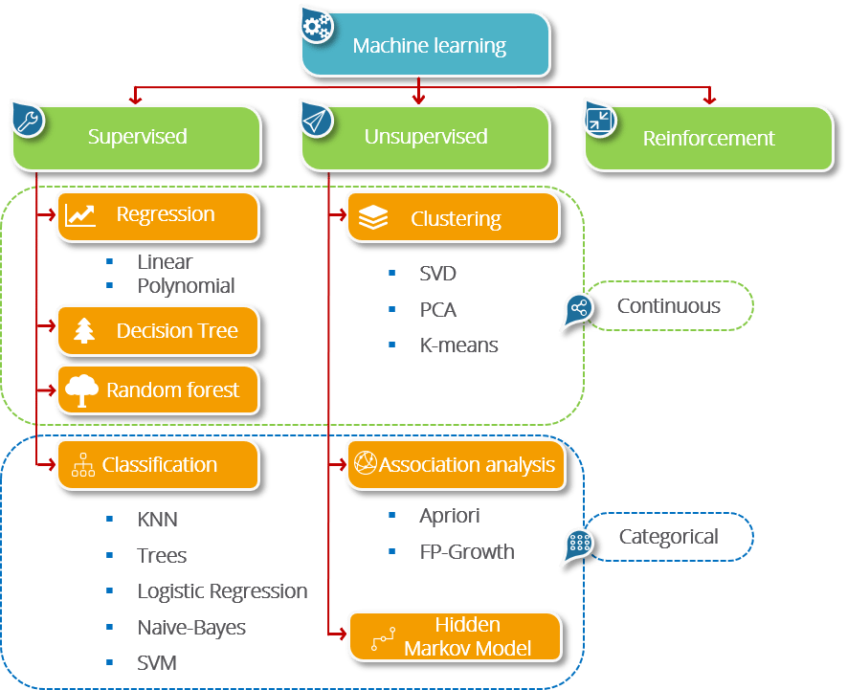
3. Types of Machine Learning
Supervised Learning – Train Me! (target are dependent variables)
Unsupervised Learning – I am self sufficient in learning
Semi-supervised Learning: combination of both methods, when cost to label are high
Reinforcement Learning – My life My rules! (Hit & Trial)
Notes:
https://www.edureka.co/blog/what-is-machine-learning/

Slide 10
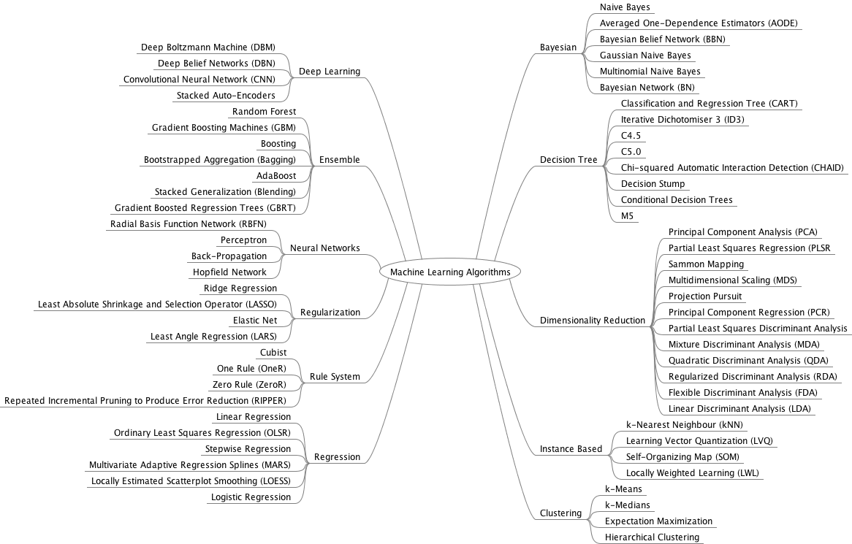
3. Types of Machine Learning

Slide 11
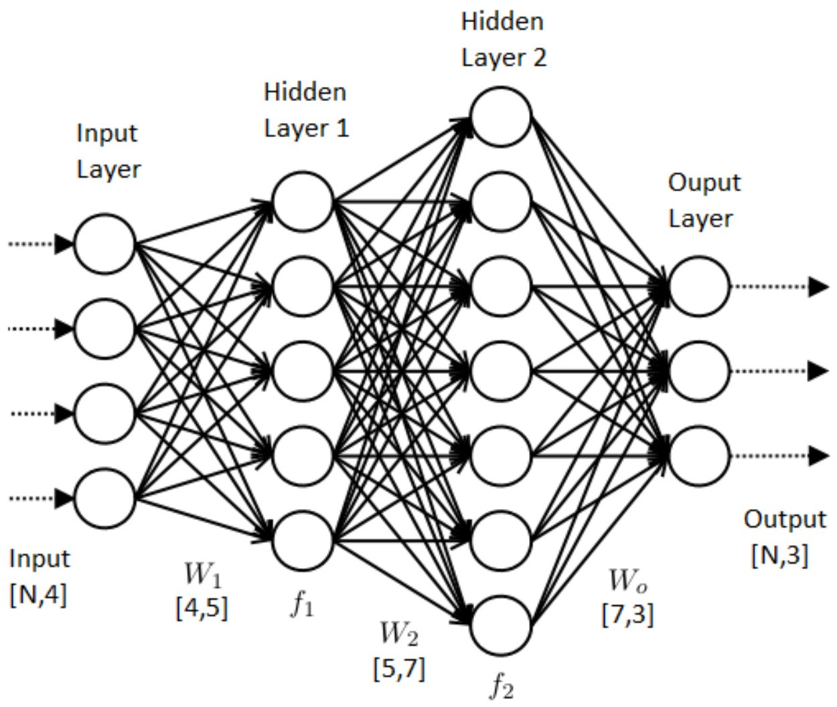
3. Types of Machine Learning
Terminology
SUPERVISED LEARNING ML ALGORITHM
Input variables
Independent variables
Predictors
Features
Input Field
Output variables
Dependent variables
Predictand
Target variables
Outcome Field

Slide 12
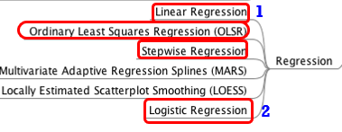
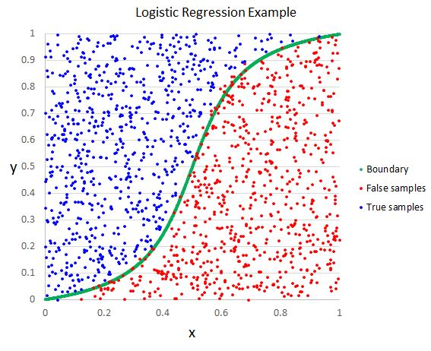
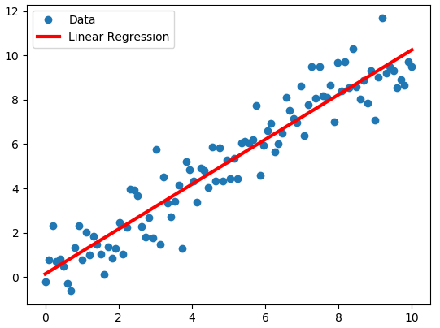
3. Types of Machine Learning
Regression based methods
Parametric approach
Most popular & widely used in research for engineer
Easy to explain and apply
The relationship between dependent variable and set of independent variables is estimated by probabilistic method/error function minimization

Slide 13
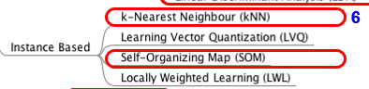
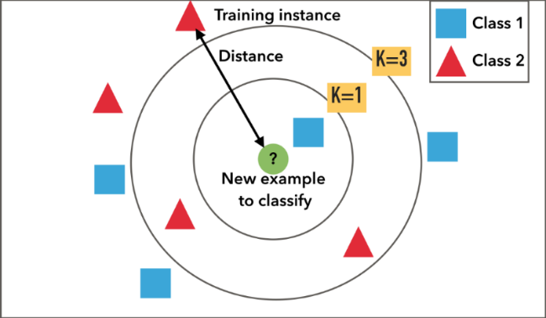
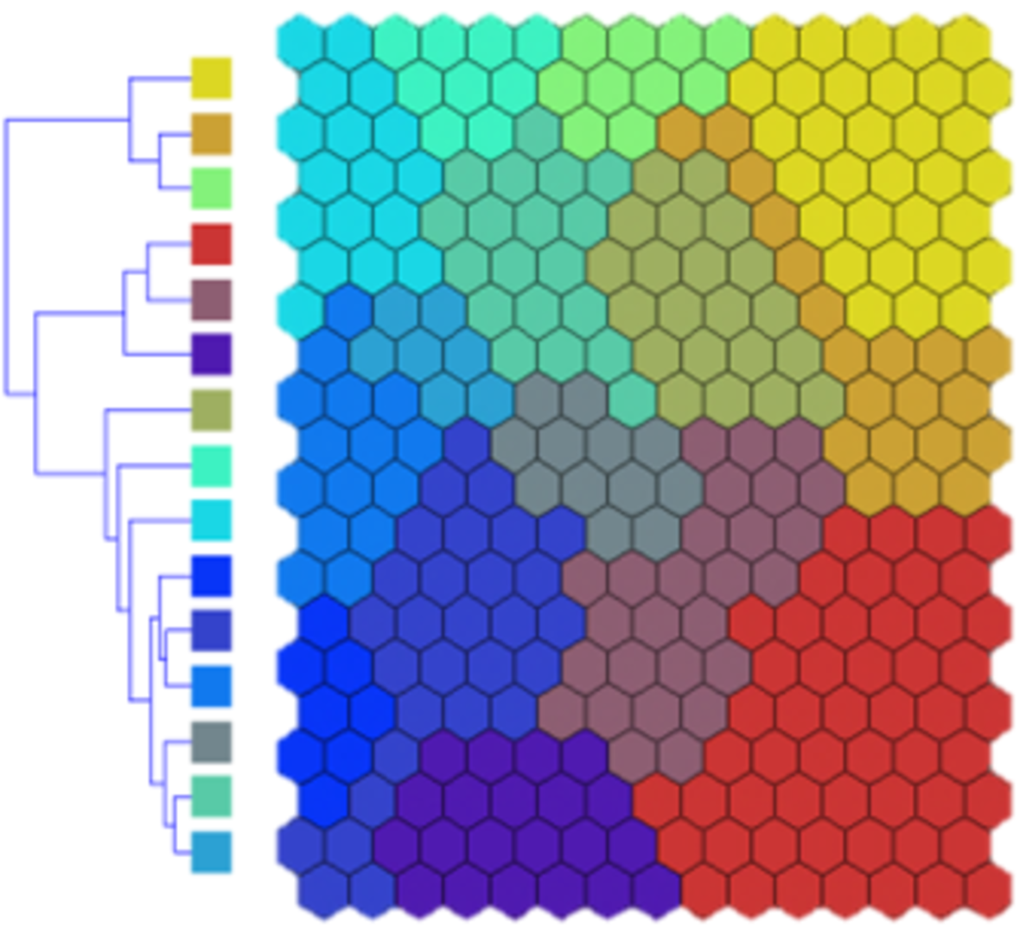
3. Types of Machine Learning
Instance based methods
Non-parametric approach/Data driven approach
So called Distance-based, event-based or memory-based learning
Self-learning and create a metric to identify whether an object belongs to the class of interest or not
Learn from sets of events/instances captured in the data
Simple but memory intensive

Slide 14
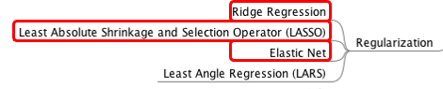
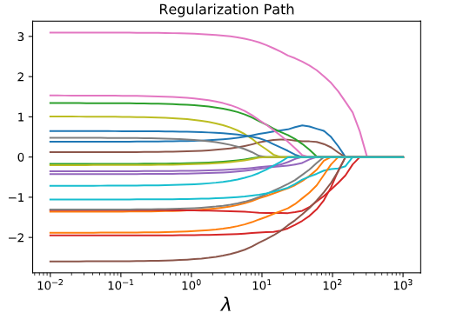
3. Types of Machine Learning
Regularization methods
An extension of regression methods
Introduce a penalization term to the loss function for balancing between complexity of model and improvement in results
Powerful dealing with large number of input dataset and trim down the input variables

Slide 15
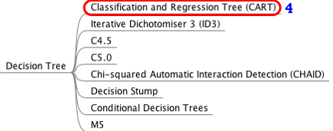
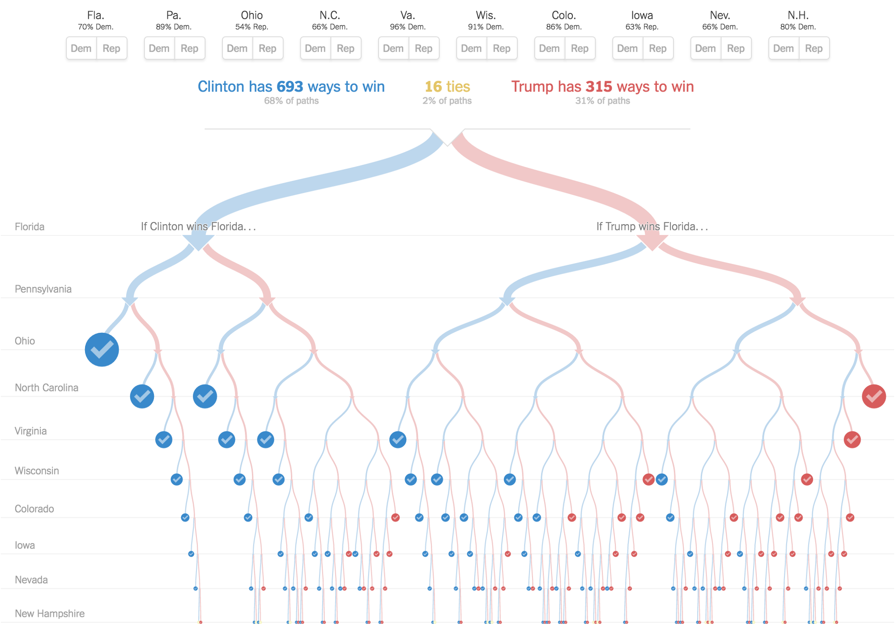
3. Types of Machine Learning
Tree-based algorithms
Sequential conditional rules applied on the actual data
Rules are applied serially and a classification decision is made when all conditions are met
Fast and distributed algorithm

Slide 16
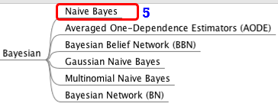
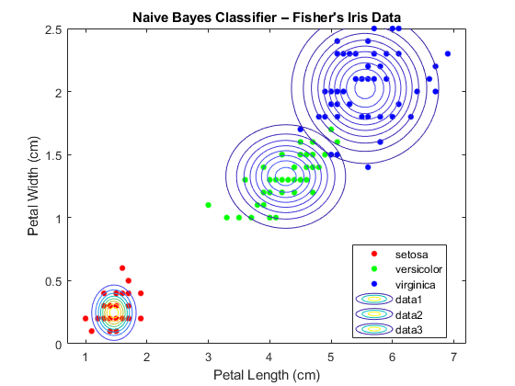
3. Types of Machine Learning
Bayesian Algorithms
Work based on Bayes Theorem using prior and post distribution
The machine does not learn from iterative process but using inference from distribution of variable
Used in most classification and inference testing

Slide 17
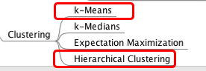
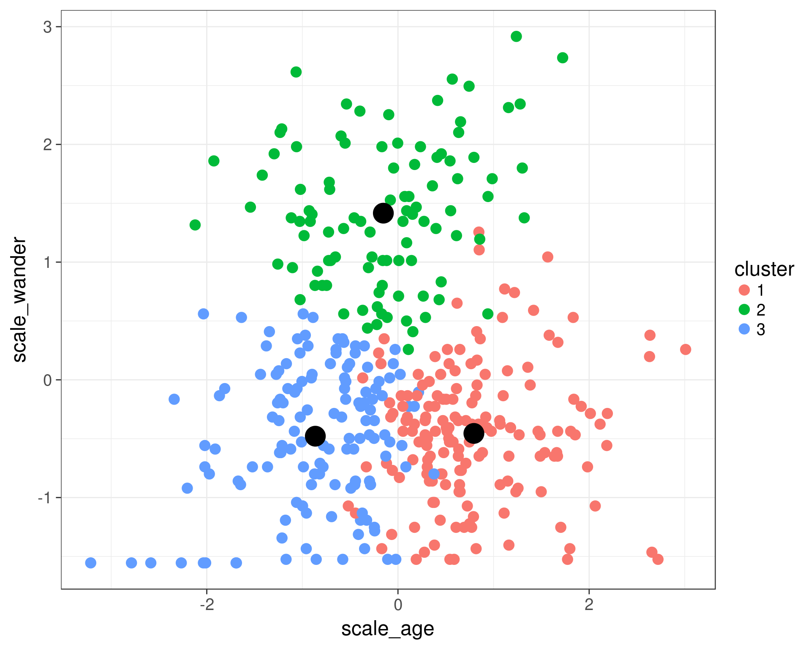
3. Types of Machine Learning
Clustering Algorithms
Principle of maximization of intra-cluster similarities and minimization inter-cluster similarities
The measure of similarities determines how the clusters need to be formed
Unsupervised algorithm: group the data for maximum commonality

Slide 18
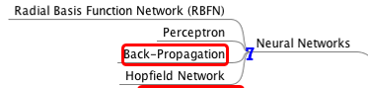
3. Types of Machine Learning
Artificial Neural Networks (ANN)
Inspired by the biological neural networks
Powerful to learn non-linear relationships
Recognize higher order relationships among variables
Used in both supervised/unsupervised learning

Slide 19
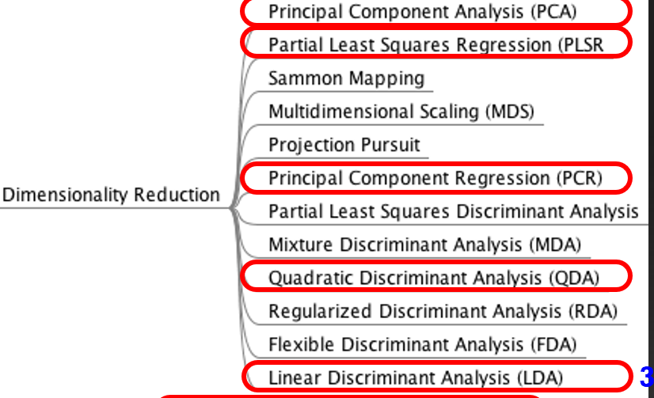
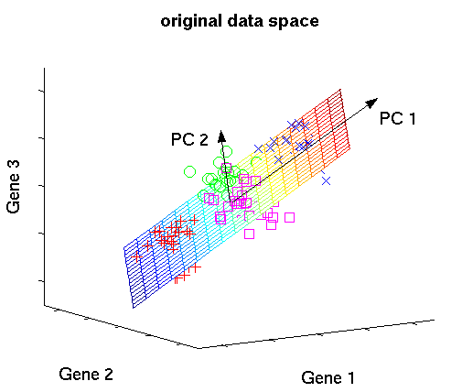
3. Types of Machine Learning
3. Types of Machine Learning
Dimensionality Reduction Algorithm
Essential method to amplify the signal in data by various transformation
Reduce number of independent variables (inputs)
To be applied before modeling

Slide 20
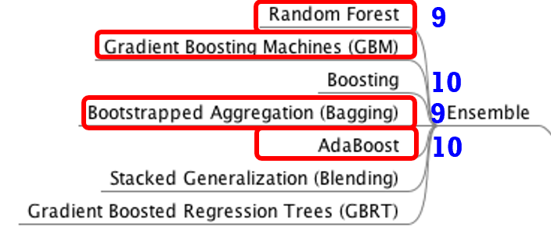
3. Types of Machine Learning
3. Types of Machine Learning
Ensemble Learning
Combination of results from different ML approach
Very popular as they have ability to provide superior results
Possibility to break into independent model to train a distributed network

Slide 21
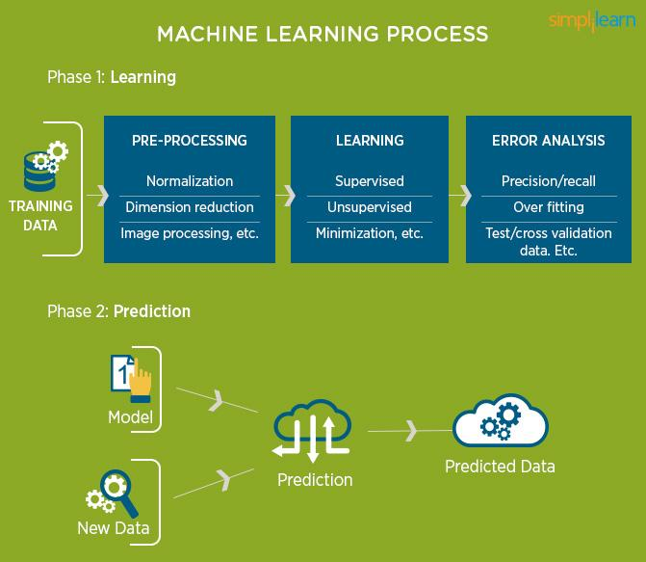
3. Types of Machine Learning
3. Types of Machine Learning
Notes:
https://www.simplilearn.com/what-is-machine-learning-and-why-it-matters-article

Slide 22
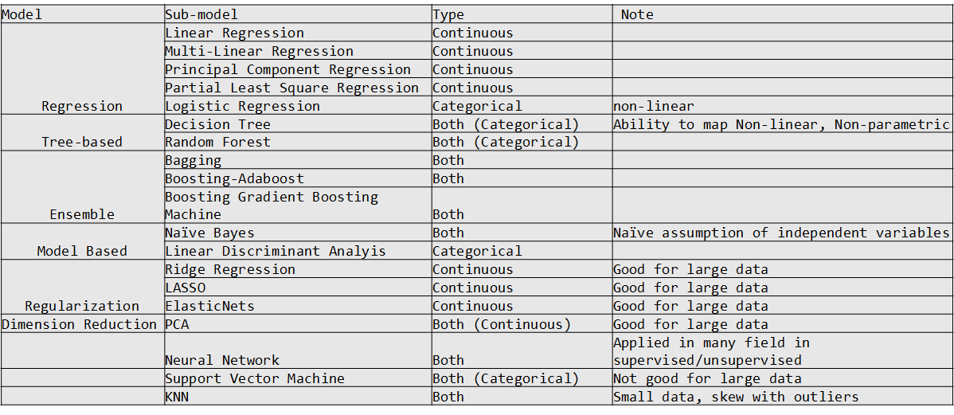

Slide 23
4. Scikit-learn
Scikit-learn or sklearn is probably the most useful library for machine learning in Python.
The sklearn library contains a lot of efficient tools for machine learning and statistical modeling including classification, regression, clustering and dimensionality reduction.
The sklearn package contains tools for:
- Data splitting
- pre-processing
- feature selection
- model tuning using resampling
- variable importance estimation
as well as other functionality.

Slide 24

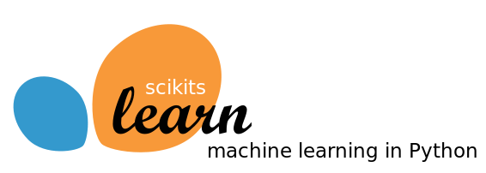
https://scikit-learn.org/stable/tutorial/machine_learning_map/index.html

Slide 25
4. Scikit-learn
Install sklearn and create the Jupyter Kernel to work using Open OnDemand platform for M2 HPC (setup)
Before the workshop, make sure that everyone has SMU HPC M2 account and created the ML_SKLN kernel with scikit-learn installed.

Slide 26
HANDS-ON
4.1 Preprocessing with missing value
4.2 Preprocessing: transform data
4.3 Data partition: training and testing
4.4 Train and predict the model
4.5 Post-processing: Evaluate test result

